Slide 1
MOVIE RECOMMENDATION SYSTEM

Slide 2
Outline
Introduction
Business Problem
Objectives
Findings
Modelling
Conclusion
Recommendations

Slide 3
Introduction
At RV Studio, we are on a mission to revolutionize the way users discover and enjoy movies. Our goal is to create a recommendation system that not only enhances user engagement and satisfaction but also delivers personalized movie suggestions tailored to each user's unique preferences.
We analyzed The MovieLens dataset developed by the GroupLens Research Lab at the university of Minnesota, which comprising of movie ratings provided by users and metadata data such as movie titles, genres and release years.

Slide 4
Business Problem
To improve user engagement and enhance the overall user experience, this project seeks to create a recommendation system model that provides personalized top 5 movie suggestions to users. These recommendations will be based on the user's ratings of other movies, ensuring that the suggestions are tailored to their individual preferences.

Slide 5
Objectives:
1. The system aims to enhance user engagement and satisfaction by providing tailored movie suggestions that align with their preferences
2. To create a recommendation system that utilizes collaborative filtering to analyze user ratings.
3. Generate accurate movie recommendations for each user

Slide 6
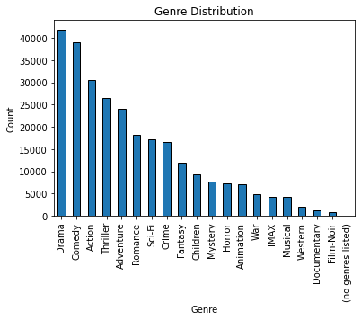
Findings
This bar graph shows that the most watched top 3 genres are:
Drama
Comedy
Action.

Slide 7
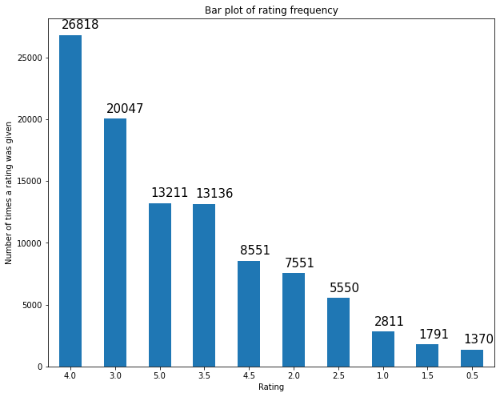
Findings
Most of the users gave a rating of 4.0 for the movies they watched

Slide 8
Modelling
Memory-based collaborative filtering
We used item-based vs user-based modelling.
Memory-based collaborative filtering makes recommendations based on similarities between users or items.
It is easy to understand and implement. It doesn't require complex computations.
Model-based collaborative filtering
We used Singular Value Decomposition (SVD) and KNN (K-Nearest Neighbors) methods.
Model-Based Collaborative Filtering uses machine learning models to make recommendations.
It can handle sparsity better and can scale to larger datasets.

Slide 9
Model Findings
User-based collaborative filtering outperforms item-based collaborative filtering in terms of both MAE and RMSE. Therefore, for memory-based collaborative filtering, it is recommended to use the user-based approach.
Both SVD and KNN significantly outperform memory-based collaborative filtering methods.
Based on the performance metrics and objectives, the KNN model is the best choice for our recommendation system. It provides the most accurate movie recommendations for each user.

Slide 10
Conclusion
User-based collaborative filtering model performed better than item based collaborative model approach in terms of prediction accuracy. This indicates that considering similarities between users yields better recommendations for individual users.
KNN is the best performing model based collaborative filtering technique.

Slide 11
Recommendations
Recommendation system will improve user engagement and satisfaction by offering personalized movie suggestions. This can lead to increased user retention and loyalty.
The system's ability to generate accurate movie recommendations for each user, based on their unique preferences and viewing history. This can lead to a higher likelihood of users enjoying and engaging with the recommended content.
The system will align movie suggestions with each user's preferences, ensuring that they receive recommendations that are tailored to their individual tastes. This personalization can enhance the overall user experience and satisfaction.

Slide 12
Recommendations
Implementing this recommendation system can give RV Studio a competitive advantage by offering a unique and personalized movie recommendation experience to users. This can help attract new users and retain existing ones.
Recommendation system will contribute to an improved user experience by making it easier for users to discover new and relevant movies. This can lead to increased user satisfaction and engagement with the platform.

Slide 13
Further Analysis
Further research to be develop hybrid recommendation systems that combine multiple recommendation techniques to leaverage on its strengths.
Investigate additional features such as demographic to help improve on recommmendation model accuracy.

Slide 14
Authors
Stella Ndegwa
Brian Kanyotu
Vivian Maiyo
Shalom Irungu
Diana Mbuvi
Josephine Gathenya

